Slide 1

Spotlight on RPA
RPA Quick Start Guide & Use case

Slide 2



RPA quick start guide
CHECKLIST
Data is standardized, structured and in electronic form
Process is rule-based, well-defined business logic
Process is resource intensive (# man-hours)
RPA Champions committed and dedicated to RPA project
RPA project scalable within Amgen (bonus)
Open mindset is key
SME to provide domain knowledge
Opportunity to learn new technology

Slide 3
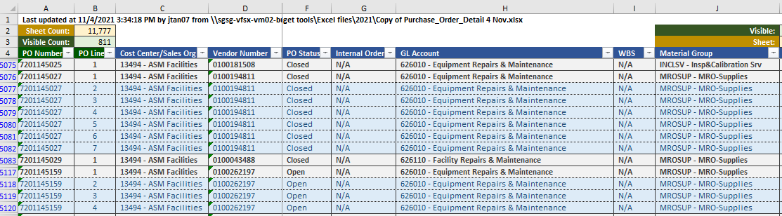
RPA use case – po expenses allocation
Sample data input
Automating (filtering & selecting) PO expense classification

Slide 4
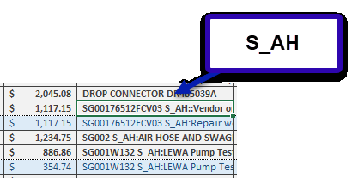
RPA use case – po expenses allocation
RPA filters and identifies Key Words for ‘Engineering Ad hoc’ expenses

Slide 5
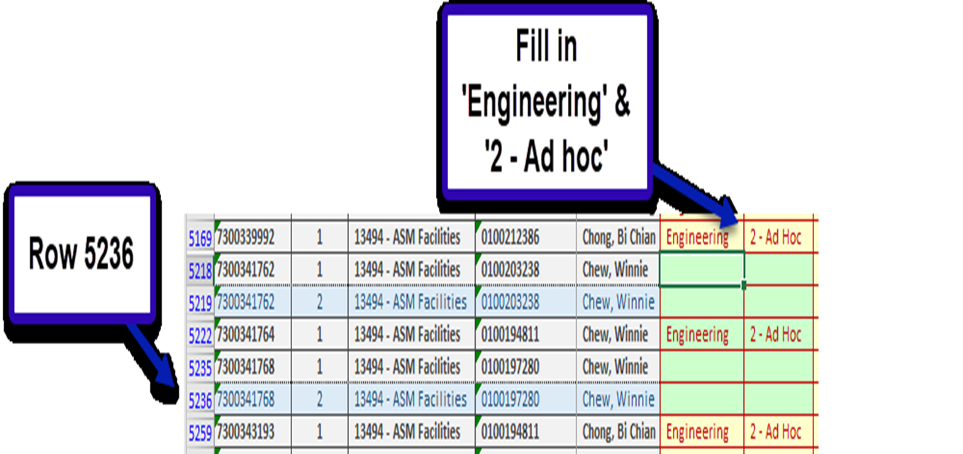
RPA use case – po expenses allocation
RPA scans and iterates through data Rows
RPA fills in ‘Engineering 2 - Ad hoc’

Slide 6


Q & A

